Slide 1
Using Your UI To Lead The User (To Do What You Want)
Al Wilkinson

Slide 2
Hi! I’m Al ☺
First program in Logo in 1985 in 1st grade #loveatfirstbyte
Started HTML in 1996, led to web apps
Written device drivers, console apps, desktop apps, services, websites, and mobile apps
Worked as code monkey, dev team lead and manager, architect, and product lead
Currently at Balance Innovations working with web and mobile
Presentation available at: https://github.com/zealouscoder/presentations
Notes:
--Wrote my first program in Logo in 1985 in 1st grade, different forms of BASIC at various times through high school
--In high school and a year in college, I did newspaper layout
--Started HTML in 1996 at University of Illinois as an engineering student, added JavaScript not long after and CSS once it was created and supported.
--Have worked in a variety of types of software in a variety of sizes and types of companies
--Have worked in a variety of roles in software
→So I often have some unique and different ideas and experience with how users may interact with software ☺

Slide 3
Why Are We Here?
To understand how users approach and interact with software
Notes:
UX is a big term that means a ton of different things to people. This session is not about best practices for user testing or integrating UX design processes in your development processes, nor does it have a technical or implementation focus with CSS or Photoshop secrets. In this session, we are going to look at how users approach and interact with software by looking at some ways our brains respond to some of the systems we interact with. Understanding these kinds of ideas can help anyone improve their software.
The reality is that most people that work in software are not usability experts, and most companies do not have one on staff. There are 10’s of thousands of usability experts and almost 1 billion websites and probably more mobile apps, so the math suggests that the rest of us should have some basic understanding of how to design software.

Slide 4
A Few Terms So We Speak The Same English
App / Software / Application
Anything with a graphical interface you write and a user can use – desktop app, website / web app, mobile app, mobile website, etc
Graphical Interface / Graphical User Interface (GUI)
The visual portion of any app (that is not a console app) that provides a way for users to interact with the app
UX / User Experience
A person’s overall engagement with something, especially in terms of how easy or pleasing it is to use
The study and understanding of the user’s experience in order to improve it
Notes:
There are a few terms that can mean many things so I want to take a minute to get us on the same page for this conversation. You will also find that I use some of these terms interchangeably.

Slide 5
Building Blocks
The User’s Mental Model – every user’s preconceived ideas and notions about any system they are going to use
Every other system the user has previously used affects their mental model when they start to use your software
Previous experiences may or may not be very applicable, but they will factor in
Notes:
First some building blocks…
-The User’s Mental Model:
--People are very active problem solvers who always have a general model in mind that drives their behavior in a very systematic way. And we are constantly refining and revising this model as we encounter new experiences.
--So when a user approaches a new system – a chair, pen, headphones, the latest bird game – they already have a mental image of what it is going to be and how it is going to work. This model may or may not be accurate.
--Previous experiences may or may not be very applicable:
--The user has never used a website that does what your does, but they have used desktop apps
--The user has read magazines and newspapers for decades, and just picked up a tablet for the first time
--A child has been reading on a tablet as toddler and now tries to use a book
It’s all about understanding where users are coming from and what is driving their behavior. What they have seen and experienced before drives their expectations when they use your software.

Slide 6
Passing The Rock
http://www.theinvisiblegorilla.com/videos.html
Notes:
Setup
--This is a short video, about 1 minute and a half
--There is a question to start the video, some action to observe, and finally the answer and some follow up
Post video:
--How many saw the gorilla?

Slide 7
The Mental Model Meets The Bear
More info at http://www.theinvisiblegorilla.com/
This original video was created to study change blindness
Around 50% of participants did not see the gorilla or bear or other changes in different variations
The research revealed two surprising observations
We miss a lot of what goes on around us
We have no idea that we miss so much
Possible causes include:
Capacity
Expectation
Conspicuity
Working Memory
Mental Workload
Notes:
--This video and variations were originally created for studying change blindness and inattenional blindness, but have been used for many different reasons. In the UX realm, this is often used to make the point that you must observe whole systems to be able to identify the problems that need to be solved. Initial user testing and research approaches are a big area in UX, which we are not going to focus on today.
--Today we are going to focus on a different aspect of the video – if you correctly frame your software, or any system, most of the time your users will do exactly what you lead them to do.
--In all its variations over 40 years, on average around 50% of people do not see the bear or other changes.
--Many have created similar videos dating back to the 1970s, but Daniel Simons and Christopher Chabris at Harvard University have some of the best known studies during the 1990’s. Their research revealed two surprising observations:
--We miss a lot of what goes on around us
--We have no idea that we miss so much
--Various research has combined to identify some possible causes including:
--Capacity
--Expectation
--Conspicuity
--Working Memory
--Mental Workload
We will see these show up in different ways as we continue through this session

Slide 8
Who Is Going To Use My Software?
Identify your target audience
What is their level of technical ability?
Is your software something they are choosing to use or something they are forced to use?
Will they be doing other things while using your software?
What devices are they using?
Notes:
So let’s start with the who:
--Identify your target audience → who is going to use your software?
--What is their level of technical ability? Technically inclined or your 90-something year old great grandmother that has fought for 20 or 30 years?
--What devices are they using or not using? Phones, tablets, laptops, desktops, multiple monitors, TVs?
--Is your software something they are choosing to use or something they are forced to use? Required by their day job or something they choose to use on their own time?
--Will they be doing other things while using your software? Are they going to be focused, multitasking, or really distracted
→ These kinds of questions help setup the capacity and expectation of your users

Slide 9
Drawing The User’s Attention
Follow common, general conventions
Break pages into visually defined areas
Have a clear visual hierarchy on the screen
Minimize noise
Notes:
From Steve Krug’s Don’t Make Me Think…
There are a wide variety of factors that affect how a user flows through a “page” or “screen” in any system, and software is a prime example of that.
Minimize noise – white space is not bad, in fact there is a whole movement of design that suggests more whitespace is good…

Slide 10
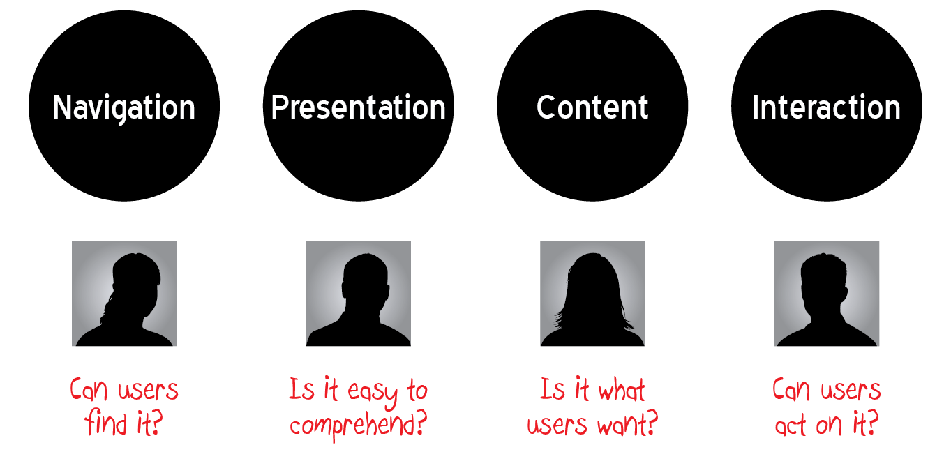
Elements of Good Design
Notes:
Because users look at so many different systems all day long, there are a few general elements we can identify to help our designs along
Characteristics of Usable Interfaces
Easy to learn
Easy to remember
Consistent
Efficient
Self-evident
Prevents errors
Provides appropriate feedback
Satisfying and fun to see

Slide 11
Navigation
Tells user where they are
Shows the user where they can go and how to get there
Shows user how they can go back
Provides users with alternatives
Is obvious to the user
Matches the user’s mental model
Notes:
--Tells user where they are → like breadcrumbs
--Shows the user where they can go and how to get there → top and side navigation, other quick and featured links on the sides
--Shows user how they can go back → breadcrumbs or sometimes a history
--Provides users with alternatives → any link on a page
--Is obvious to the user → if it looks like a link, navigates like a link, it might be a link
--Matches the user’s mental model → is it where the user expects? Does it take them where they expect to go?
The true challenge behind navigation is that in the last decade we have introduced so many new types of devices that our expectations have been changing. However, I think you will find that each device and each type of app has some standards that are settling in.

Slide 12
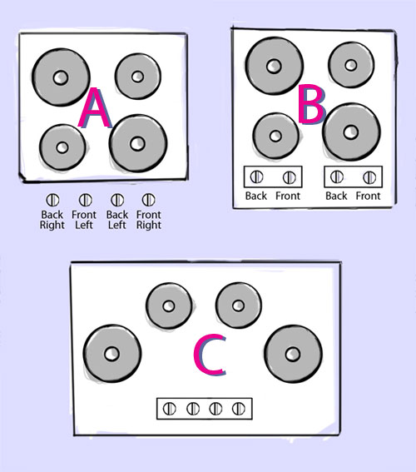
Challenging The Norm
Notes:
Conventions are good, but sometimes they require more brain power than they should. Consider stove top design. Which would you prefer to have in your kitchen? Sometimes we have to challenge current conventions to design better ones.
Next slide:
--See what jumps out at you first…

Slide 13
Visual Hierarchy
Least Important
Medium Importance
Most important information on the screen
Notes:
--Where did your eyes go first?
--When did they read the text?
--Size directs our eyes through a visual hierarchy, and usually is more powerful than the actual contents

Slide 14
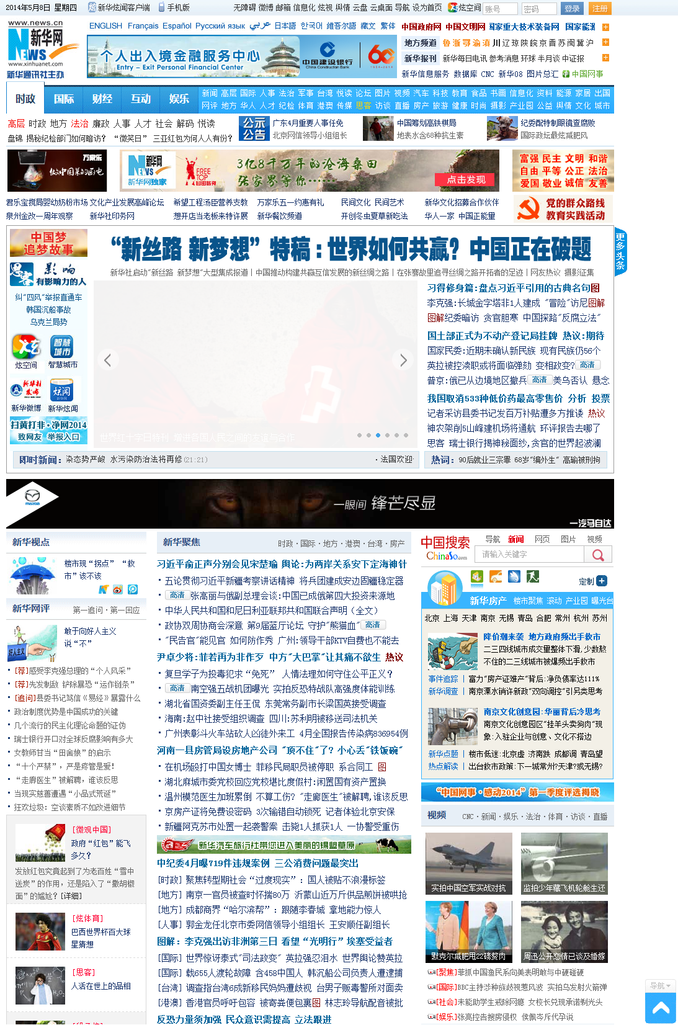
Conventions and Areas
Looks the same, even in a different language
What can we tell about this site?
Notes:
This is a screen shot of a Chinese news site - http://www. xinhuanet.com/ on 5/5/2014
Obviously this is not in English. Does anyone speak Chinese?
What are some of the things that jump out at you, that you can identify?

Slide 15
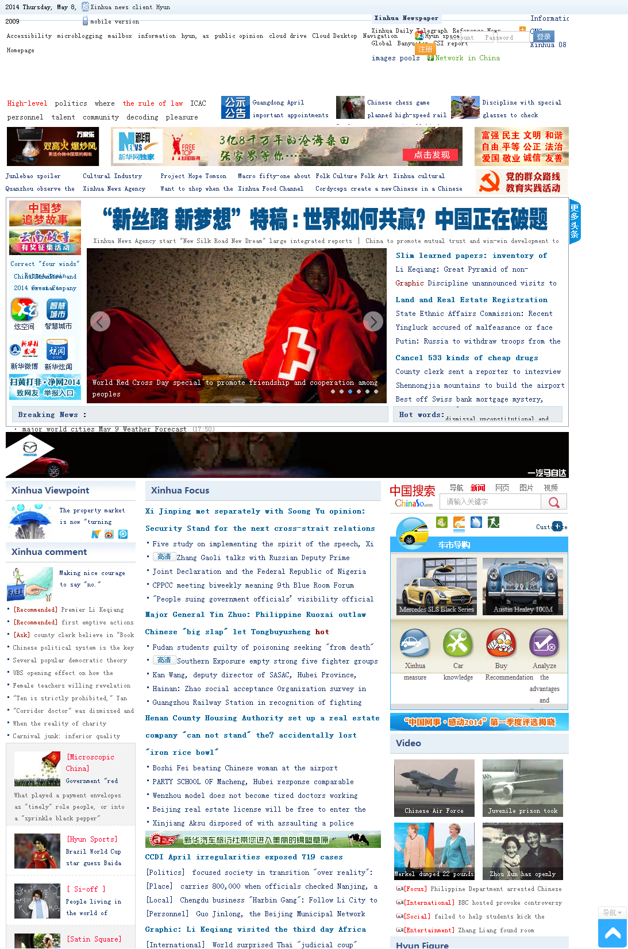
Conventions and Areas
Good guessing!
Notes:
I used my browser to translate the page to verify. It came out very poorly because the English words take up much more space than the Chinese characters. But it turns out we are all on the right path. Some highlights (top going down):
Some links and info, perhaps a date, and maybe on the right is a language selection or login
Logo and banner near the top
Some other links that are maybe for languages or versions of the site, possibly a mobile version
Top and side navigation
Some ads or featured previews
Large headline for the main story with some rotating images
Two different sections for news or feature article
Search
Stock or weather or other sections of news
Videos
In looking at the collection of Chinese characters may have forced you to think through some standards of different types of software, like:
--desktop apps tend to have a main menu bar
--mobile tends to scroll up and down, not side to side
--every OS has some conventions
→ Examining some basic conventions of other similar apps may reveal significant details about your average user’s mental model when they open your software

Slide 16
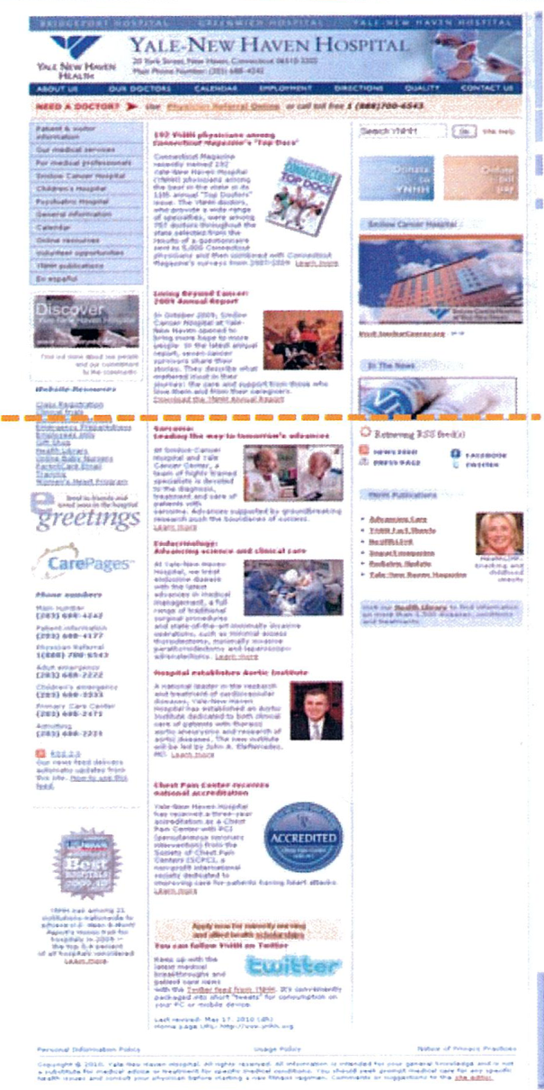
Page Layout
Above the fold
Portion of the page that is initially viewed without scrolling
Must contain critical information, navigation, context, links, and graphics
Below the fold
Requires scrolling to access
Should contain supporting information
Repeat navigation below the fold on long pages
Notes:
Sometimes the visual flow comes from our expectation of top to bottom, right to left reading of text. We learned that from books and magazines as kids, and many English based systems still follow that. Similarly, newspaper design from 100 years ago still shows up in many websites – like a banner are the top of the page and boxie groupings of related content. And we carry some newspaper terms like “the fold”
It is important to think about how much a user has to scroll. Consider the amount of content you have on different devices.

Slide 17
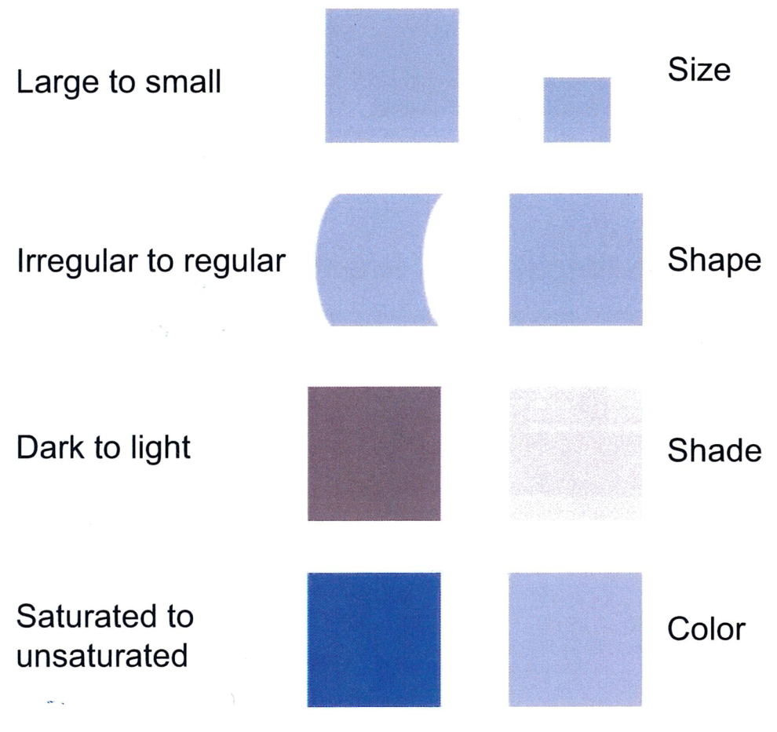
Shapes
Research indicates people’s eyes tend to move in specific patterns
When we fight the brain’s expectations, software can seem difficult to use, or users may miss whole portions of the app

Slide 18
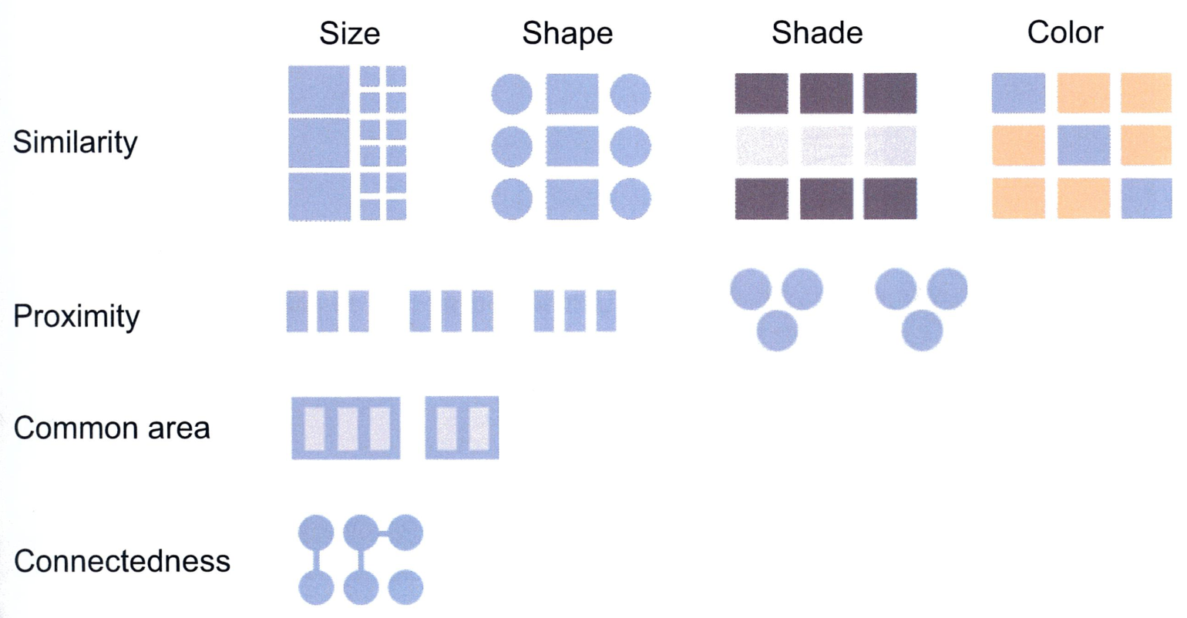
Grouping
Gestalt refers to the human perceptual process that allows people to interpret stimuli holistically
Gestalt principles help designers control visual context
Notes:
Gestalt
--There are several principles related to perception in the human visual system
--German cognitive scientists in the 1920s
--German word for "form" or "structure“

Slide 19
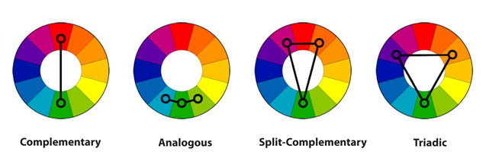
Color Me Happy
Colors set the tone for what you see
Warm colors – ranging from red-violet to yellow
Cool colors – ranging from violet to green-yellow
Complementary colors – colors that are directly opposite
Analogous colors – any 3 consecutive color segments
Split-complementary - two split colors adjacent to direct opposite complementary
Triadic colors – colors that are separated by 120 degrees
Notes:
Colors do not just direct users, they also set the tone of the software

Slide 20
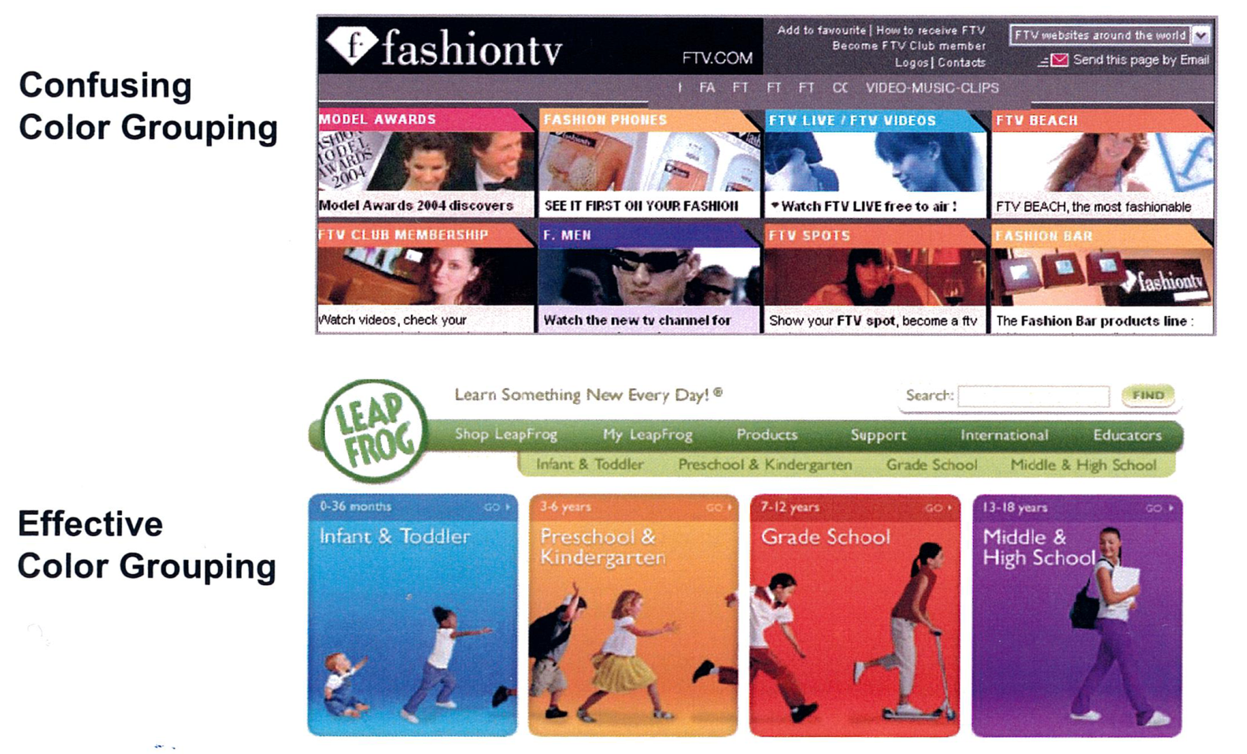
Color Me Happy
The brain naturally uses color as a cue to group objects and show relationships between them
Color can help reinforce brands and common messages
Notes:
There are good and bad color groupings
--Notice the shapes suggest similarities for the 8 different boxes. However, there are some reused colors, which suggests they are the same. But you would typically only have one item per group in a structure like this, I think, or maybe not, or … etc., etc., etc. My brain started thinking too much about this, how about yours?
--The Leap Frog site is a much more clear example by choosing very distinct colors and only using them once. Plus they are bright and engaging, and they are consistent from visual perspective.
--Brands typically have specific sets of colors they use and re-use to identify themselves without reusing their logo everywhere. Think Google.
--Similarly, we have learned that certain colors and shapes mean certain things. Like a red octagon means stop. So putting up a green circle with the word “STOP” in the middle is not going to see many people stop what they are doing. Our mental model identified the color and the shape and acted, before reading the word.

Slide 21
Color Me Confused
Not all color usage is good
Approximately 9% of men and .5% of women are color deficient.
How many colors is too many?
Notes:
--Not all color usage is good – there are some challenges:
--Approximately 9% of men and .5% of women are color deficient. Types of color deficiencies:
Anomalous Trichomats – red or green is shifted making the eye less sensitive to this color; accounts for over half of deficiencies
Small Field Tritanopia – general weakness for detecting blue due to a smaller proportion of blue receptors
Dichromats – complete loss of a color spectrum
Cone Monochromats – can see only one color; rare, about 1/1 million
Achromatopsia – true color blindness (no cones); fairly rare
→ Color deficiencies present some interesting challenges to color and conventions. Consider a stoplight if you are red or green or red AND green deficient. You must rely on the standard order of the lights to guess the intended meaning. So changing the order of a stoplight could cause serious problems for color deficient users.
--When searching for an object based on color, one color dramatically speeds search time. When more than 5-6 colors are used in the same display, performance is often slower than non-color displays

Slide 22
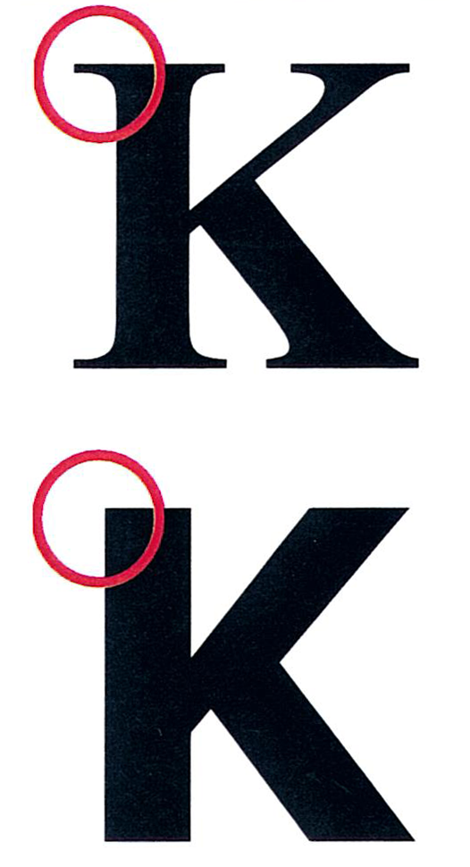
Can You Read Me Now? Good.
Fonts are graphical by nature
Font Styles
Serif
Text has “serifs” or cross-lines at the end of a stroke
Helps distinguish letters
Provides continuity for the reader’s eye
Sans Serif
Sans means without
Often preferred for its more casual look
Font Treatments
Underlining
Reserve only for clickable text
Italics
Use sparingly for emphasis
ALL CAPS
Avoid, degrades reading performance 14-20%
Different fonts: http://www.typewolf.com/blog/industry-leading-designers-share-their-favorite-typefaces
Notes:
Talking about color can easily lead into a nice discussion on good use of images. The short version is icons can be helpful or harmful ☺
--Related to graphics is fonts. Did you know that our brains do not really process letters like we think about them? We have trained ourselves to think of letters as letters, but our brain still processes them as shapes. Have you every tried reading an email or document that had the vowels or other middle letters jumbled?
--Some things that make fonts stand out include the style. There are two basic font styles.
There are also some font treatment conventions to consider.
http://www.typewolf.com/blog/industry-leading-designers-share-their-favorite-typefaces

Slide 23
Act Now!
At some point, the user will read the words
Use active voice
Strive for precise meaning
Keep it short and simple
Remove repetition
Notes:
--Despite talking about everything short of words so far, at some point, your users will actually read the text in your software. So how do we get them to read? --Use active voice – use command words like Act Now, Save This, Sign Up, Follow Me
--Strive for precise meaning – avoid words that are vague or require too much context for understanding
--Keep it short and simple – we are creating software, not a novel, save your loquacious verboseness
--Remove repetition – especially in lists, and instructions on forms, and around buttons

Slide 24
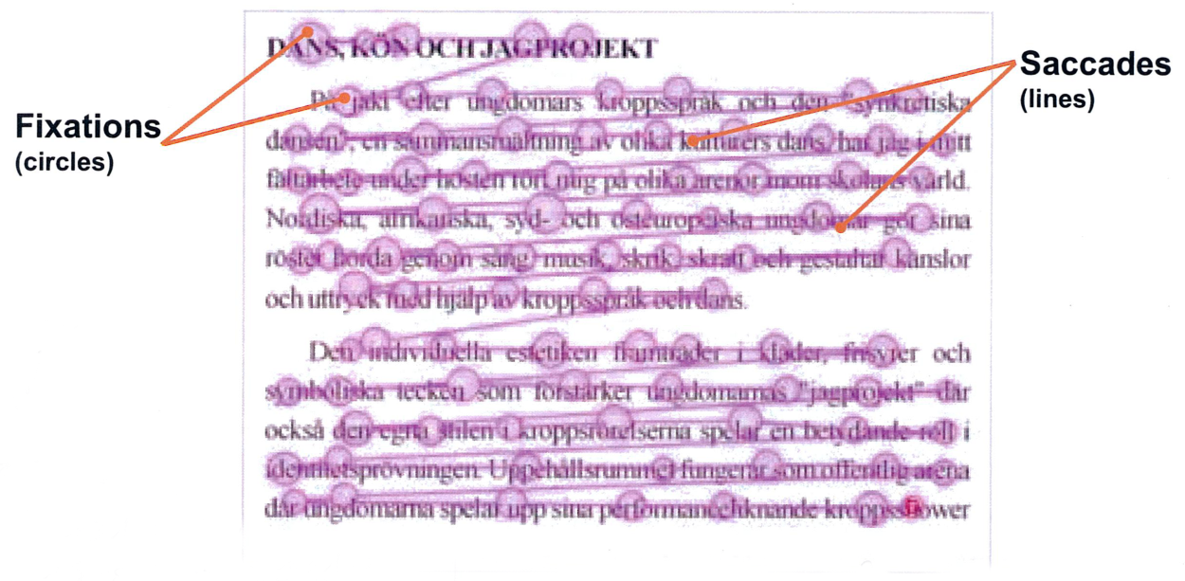
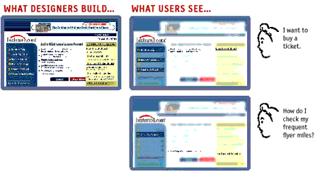
Watch Their Eyes Not Their Words
Eyes fix and scan
to read text
Users fixate on the
part of the page
they identify as
meeting their need
Notes:
As we think about reading text we can talk some more about how eyes move through a page. A couple of quick items are:
--Eyes fix and scan to read text
Fixations – Periods when the eyes stop or hesitate to focus or gaze upon a visual object
Saccades – Periods when the eyes rapidly scan within the vertical or horizontal planes of the visual field.
→ Has anyone seen the Spritz reader? It gives you the ability to read words in a single location instead of your eyes moving. I just saw this and it is an interesting way to change how a user moves through your content.
Just like words, users fixate on the part of the page they identify as meeting their need. They rarely read everything on a page, especially after they have been there a few times.

Slide 25
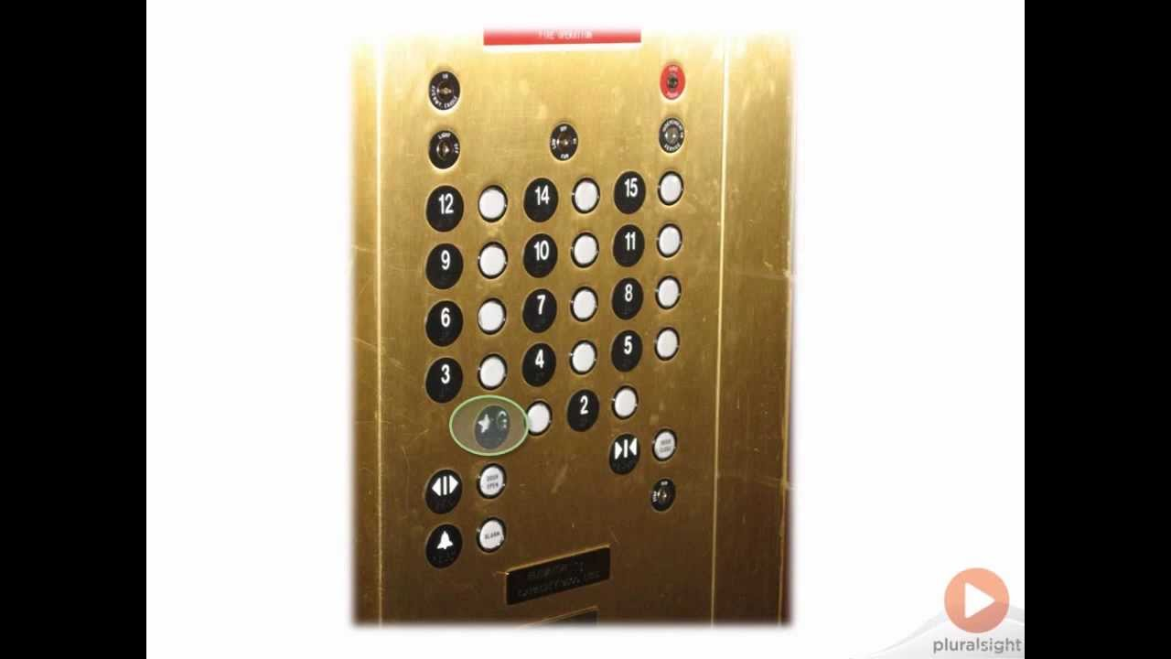
Look! Real Examples
Notes:
Theory is nice, but some real examples are always helpful. Let’s start with one of my favorites. This is from Billy Hollis’ Pluralsight video on UX. Take a look at this elevator panel and then let’s talk about what you see.
Observations:
No 13th floor, especially in cities with casinos
Alignment of the buttons is a little off
The label for the groud floor
The paint is worn off the label - people have tried to press it, many times
We expect bttons to be round in the physical world
This is a design principle called archetypes

Slide 26
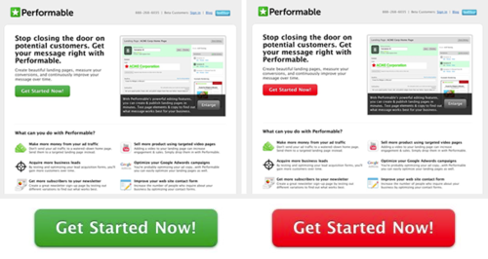
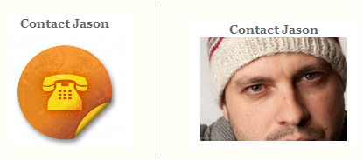
Look! Real Examples
Green vs Red “Get Started Now!” button – 21% more clicked Red
Human photo over icon “Contact” link – up to 50% increase clicks
Notes:
The next few examples are of real comparisons of some different approaches to parts of sites. These are all courtesy of a couple of Google searches, so you can probably find some that are applicable to your specific software with a few more searches. Please note, this is not a specific endorsement of A/B Testing, just some interesting results.
--Green vs Red “Get Started Now!” button
http://blog.hubspot.com/blog/tabid/6307/bid/20566/The-Button-Color-A-B-Test-Red-Beats-Green.aspx
--Human photo over icon “Contact” link
http://www.smashingmagazine.com/2010/06/24/the-ultimate-guide-to-a-b-testing/

Slide 27
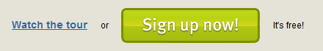
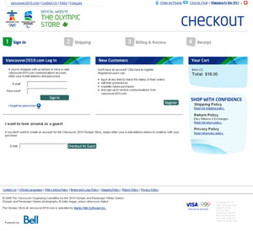
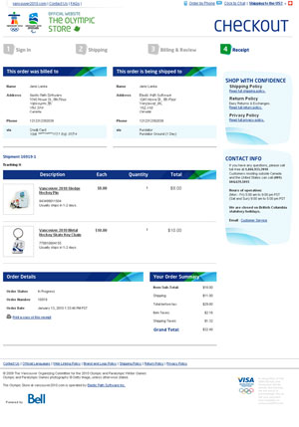
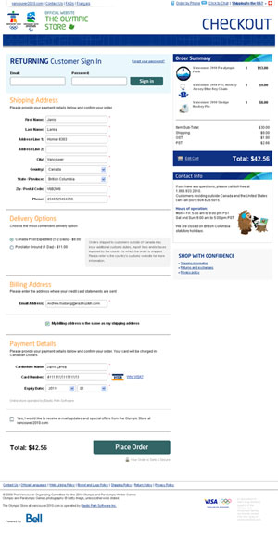
Look! Real Examples
Adding “It’s free!” increased conversion rate by 28%
Single Page over Multi-Step Checkout increased sales by 21.8%
Notes:
--Adding “It’s free!”
http://visualwebsiteoptimizer.com/split-testing-blog/ab-test-case-study-how-two-magical-words-increased-conversion-rate-by-28/
--Single Page vs. Multi-Step Checkout
http://www.getelastic.com/single-vs-two-page-checkout/

Slide 28
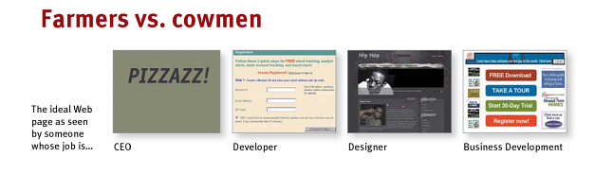
In Reality, It Depends…
Make it pretty, but focus on usable
All rules, conventions, standards, patterns, etc. can potentially be thrown out the window
Notes:
I try to keep two things in mind, because the reality is that it all depends on your specific case
--Make it pretty but it must be usable. We all like visually appealing things, and you may understand a little more about why now. But it is still important to make it usable, because a beautiful design that is not usable still results in no one wanting to use your software.
--Which rules and conventions you follow always depends on many factors. Another clip from Don’t Make Me Think is this Farmers vs. cowmen graphic. You may have to build software for all four types of people. You may only be targeting one group, or you may also be targeting many other groups. For better or worse, there is no one blanket design for all software. If there was, we might all be out of jobs ☺

Slide 29
Thanks!
awilkinson@balanceinnovations.com
zealouscoder@gmail.com
@zealouscoder
Presentation: https://github.com/zealouscoder/presentations
Notes:
So hopefully you have some new ideas about what to consider while designing or modifying your software. There are several other great sessions at the conference this weekend related to multiple aspects of UX, so I hope you enjoy!
Thanks!

